Slide 1

CODESYS
SoftMotion 运动控制
电子齿轮（Gear）
第三课 功能块介绍
主讲：黄健
时间：2022年2月

Slide 2

电子齿轮介绍
MC_GearIn(FB)
The function block couples the slave axis to the master axis specifying a certain velocity transmission ratio and applies a certain velocity ratio between master and slave velocity.
Time behavior of the coupling The slave axis is ramped up to master velocity. Coupling takes place once this is achieved. The distance lost during the synchronization is not made up.
While MC_GearIn is in operation, the transmission ratio can be changed by sequential MC_GearIn commands. To do this, no preceding call of MC_GearOut is necessary
After being ‘InGear’, a position locking or just a velocity locking is system specific.
standstill
synchronized_motion
目标速度
Vs $=Vm ∗ \frac{RatioNumerator}{RatioDenominator}$

Slide 3
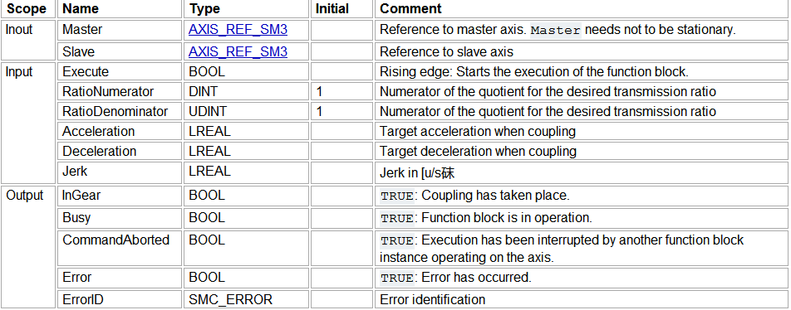
电子齿轮介绍
MC_GearIn(FB)

Slide 4
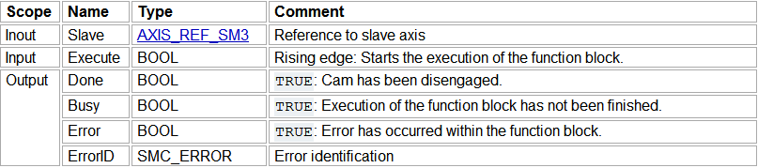
电子齿轮介绍
MC_GearOut(FB)
This function block disengages the slave axis from the master axis.

Slide 5
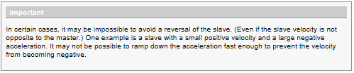
电子齿轮介绍
MC_GearInPos(FB)
MC_GearInPos couples the slave axis to the master axis taking into account a specific positional relationship.
Any previous motion is continued until the master crosses the position MasterSyncPosition – MasterStartDistance in the correct direction. At that point in time the output StartSync is set. When a stop command is executed on the slave axis before the synchronization has happened, it will inhibit the synchronization and the function block issues CommandAborted is TRUE.
If the MasterStartDistance is not specified, the system itself calculates the setting point for StartSync based on the other relevant inputs.

Slide 6
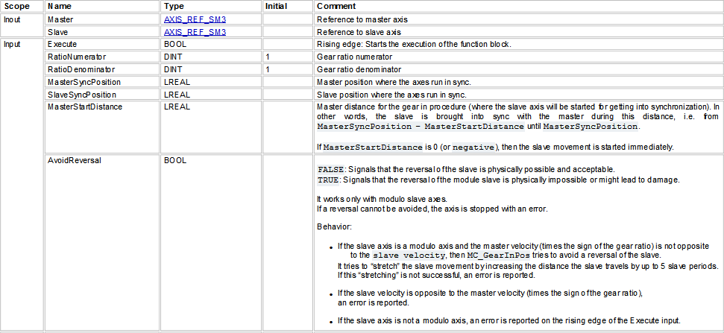
电子齿轮介绍
MC_GearInPos(FB)

Slide 7
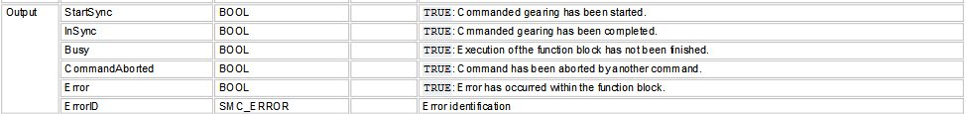
电子齿轮介绍
MC_GearInPos(FB)

Slide 8
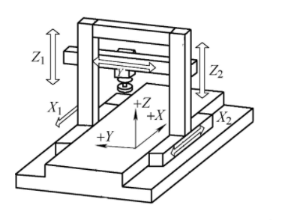
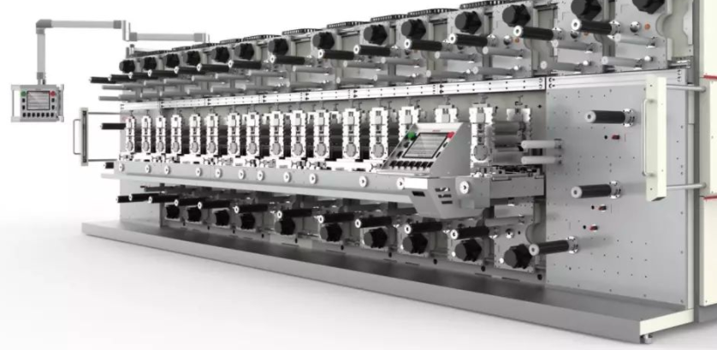
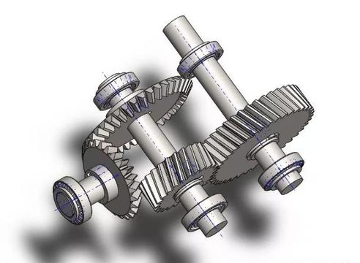
应用场景
实现多变的齿轮比耦合同步的情况；
长跨度的同方向的龙门结构；
其他需要速度同步的应用场景

Slide 9
谢谢观看
THANK YOU

